Slide 1
Three-Dimensional Transformations

Slide 2
Geometric Transformations in Three-Dimensional Space
3D transformation methods are extended from 2D methods by including considerations for the z coordinate
A 3D homogenous coordinate is represented as a four-element column vector
Each geometric transformation operator is a
4 by 4 matrix

Slide 3
3D Translation
Translation of a Point
y
P’=P·T
(x’,y’,z’)
(x,y,z)
T=(t_{x},t_{y},t_{z})
x
z

Slide 4
3D Scaling
Uniform Scaling (Scaling relative to the coordinate origin)
P’ = S·P
y
x
z

Slide 5
Relative Scaling
Scaling with a Selected fixed point (x_{f}, y_{f ,} z_{f})
y
y
y
y
z
x
z
x
z
x
z
x
Original position
Translate
Scaling
Inverse Translate

Slide 6
Other Transformations : REFLECTION
A 3-D Reflection can be performed relative to a selected reflection axis or w.r.t selected reflection plane. The 3-D reflection matrixes are set up similarly to those for 2-D.
In 2-D , Reflection w.r.t axis is equivalent to 180 degree rotations about the axis in 3- D space
whereas ,in 3-D Reflection w.r.t a plane are equivalent to 180 degree rotations in 4-D space.

Slide 7
Other Transformations : REFLECTION
Reflection Relative to the XY Plane
y
y
z
z
x
x
Reflection Relative to the XZ Plane
y
x
z
z
y
x
Reflection Relative to the YZ Plane
y
y
x
z
x
z

Slide 8
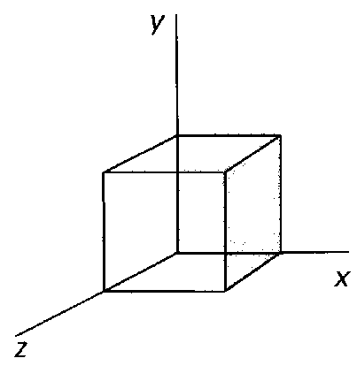
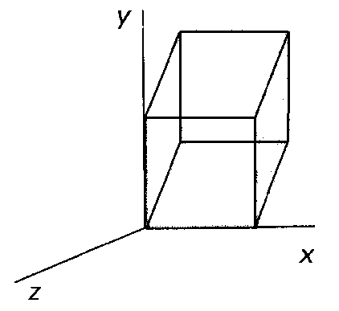
Other Transformations : SHEARING
Shearing transformation are used to modify the shape of the object and they are useful in 3-D viewing for obtaining General Projection transformations.
Z-axis 3-D Shear transformation
The effect of this transformation matrix is to alter the x and y
co-ordinate values by an amount that is proportional to the z-value, while leaving z co-ordinate unchanged. Boundaries of the plane that are perpendicular to z-axis are thus shifted proportional to z-value.

Slide 9
Other Transformations : SHEARING
X-axis 3-D Shear transformation
Y-axis 3-D Shear transformation

Slide 10
3D Rotation
Positive rotation angles produce counterclockwise rotations about a coordinate axis, assuming that we are looking in the negative direction along that coordinate axis
Coordinate-Axis Rotations
Z-axis rotation
X-axis rotation
Y-axis rotation
General 3D Rotations
Rotation about an axis that is parallel to one of the coordinate axes
Rotation about an arbitrary axis

Slide 11
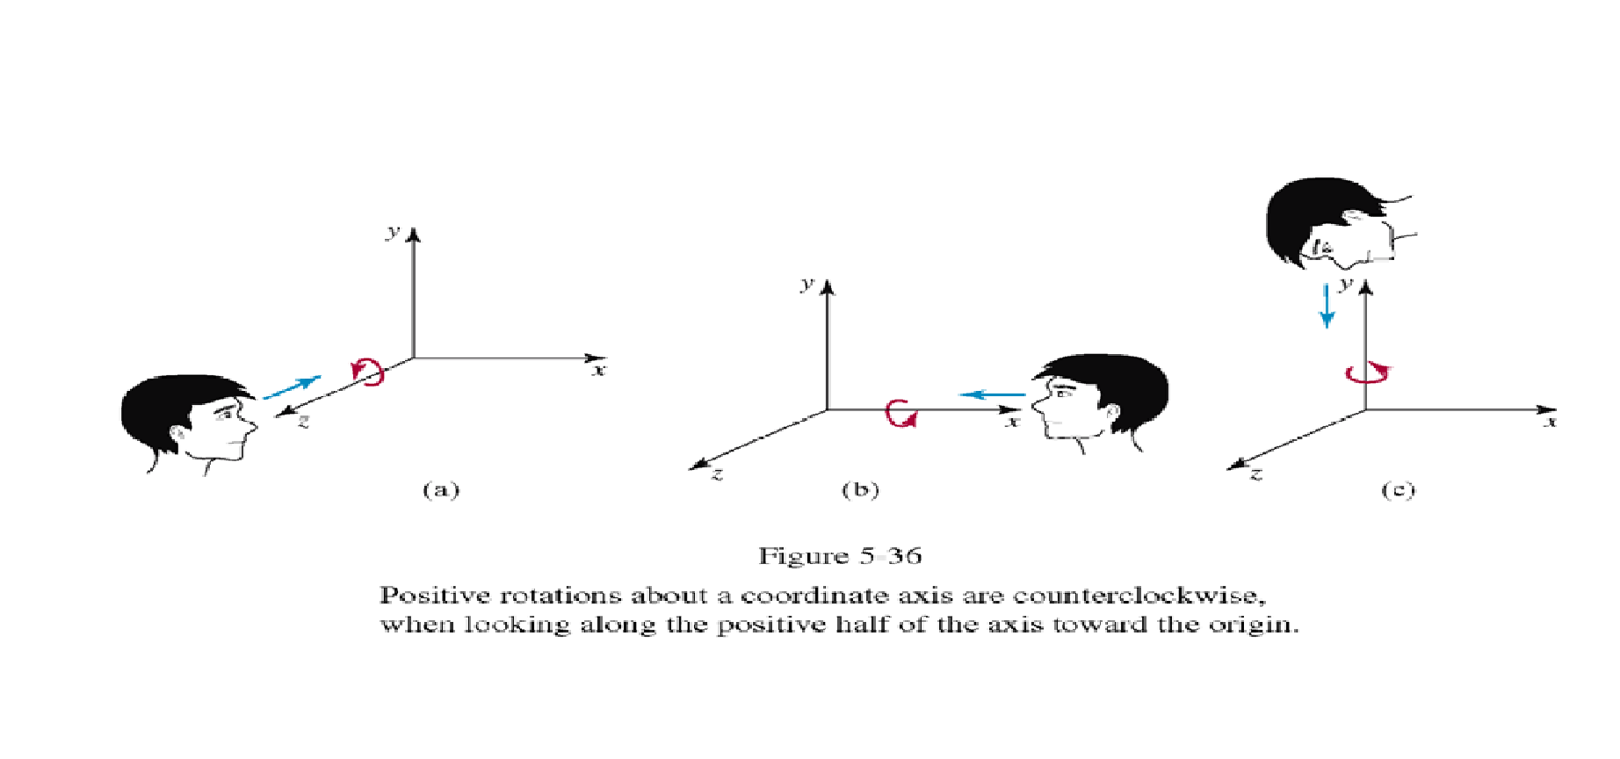
Coordinate-Axis Rotations
Z-Axis Rotation
X-Axis Rotation
Y-Axis Rotation

Slide 12
3D Rotation
z-axis rotation
x’=x cos θ - y sin θ
y’=x sin θ + y cos θ
z’=z
or, P’ = R_{z}(θ)·P

Slide 13
3D Rotation
z-axis rotation
x’=x cos θ - y sin θ
y’=x sin θ + y cos θ
z’=z
Other axis rotations
x→ y→ z→ x
x-axis rotation
y’=y cos θ - z sin θ
z’=y sin θ + z cos θ
x’=x
y-axis rotation
z’=z cos θ - x sin θ
x’=z sin θ + x cos θ
y’=y
or, P’ = R_{x}(θ)·P
or, P’ = R_{y}(θ)·P

Slide 14
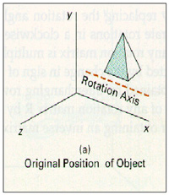
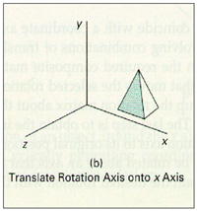
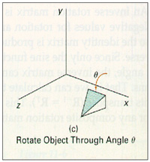
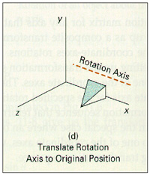
General 3D Rotations : CASE 1
Rotation about an Axis that is Parallel to One of the Coordinate Axes
Translate the object so that the rotation axis coincides with the parallel coordinate axis
Perform the specified rotation about that axis
Translate the object so that the rotation axis is moved back to its original position
Any coordinate position P on the object in this fig. is transformed with the sequence shown as below
P’ = T⁻¹·R_{x}(θ)·T·P

Slide 15
General 3D Rotations : CASE 2
Rotation about an Arbitrary Axis
Basic Idea
Translate (x1, y1, z1) to the origin
Rotate (x’2, y’2, z’2) on to the z axis
Rotate the object around the z-axis
Rotate the axis to the original orientation
Translate the rotation axis to the original position
y
T
(x2,y2,z2)
R
(x1,y1,z1)
x
R⁻¹
z
T⁻¹

Slide 16
General 3D Rotations
Step 1. Translation
y
(x2,y2,z2)
(x1,y1,z1)
x
z

Slide 17
General 3D Rotations
Step 2. Establish [ T_{R} ]^{α}_{x} x axis
y
(0,b,c)
(a,b,c)
Projected Point
α
α
x
z
Rotated Point

Slide 18
Arbitrary Axis Rotation
Step 3. Rotate about y axis by φ
y
(a,b,c)
Projected Point
l
d
β
x
(a,0,d)
Rotated Point
z

Slide 19
Arbitrary Axis Rotation
Step 4. Rotate about z axis by the desired angle θ
y
l
x
θ
z

Slide 20
Arbitrary Axis Rotation
Step 5. Apply the reverse transformation to place the axis back in its initial position
y
l
l
x
z

Slide 21
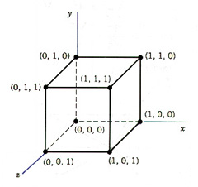
Example
Find the new coordinates of a unit cube 90º-rotated about an axis defined by its endpoints A(2,1,0) and B(3,3,1).
A Unit Cube

Slide 22
Example
Step1. Translate point A to the origin
y
B’(1,2,1)
A’(0,0,0)
x
z

Slide 23
Example
Step 2. Rotate axis A’B’ about the x axis by and angle α, until it lies on the xz plane.
y
Projected point
(0,2,1)
B’(1,2,1)
α
l
x
z
B”(1,0,√5)

Slide 24
Example
Step 3. Rotate axis A’B’’ about the y axis by and angle φ, until it coincides with the z axis.
y
l
x
β
(0,0,√6)
B”(1,0, √ 5)
z

Slide 25
Example
Step 4. Rotate the cube 90° about the z axis
Finally, the concatenated rotation matrix about the arbitrary axis AB becomes,

Slide 26
Example

Slide 27
Example
Multiplying R(θ) by the point matrix of the original cube

